Slide 1
CLASS XII Art Integration
Phone Management store:
VSR MOBILES
By:
M.Sandeep kumar(0437)
Vishnu kumar(0033)
N.Ranga Madhav(0041)

Slide 2


Softwares used:
&

Slide 3
Modules used:
OS Module : for clearing the terminal
Datetime Module : for managing admission and discharge dates
MySQL-connector : for establishing connection between the program and the database engine
Pretty Table : for tabular representation in the terminal
Time Module : for sleep function to keep timeout after input

Slide 4
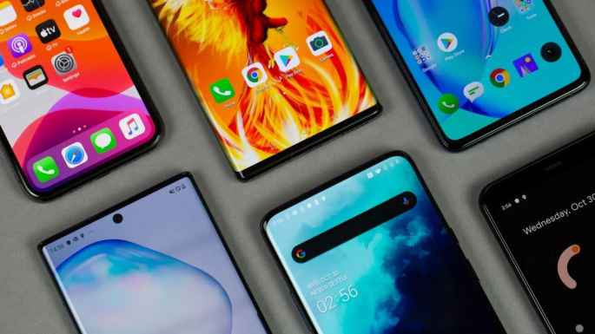
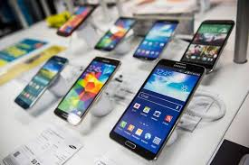
Useage of the project in our lifes
There are various phones in the market now a days
Each day a new phones launches and can’t be satisfied with a single phone

Slide 5
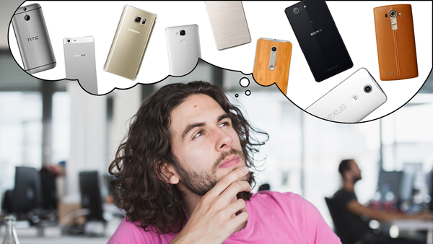
We can help you select your own phone
According to your needs.
Thinking to buy a new phone

Slide 6
HOW TO USE THIS PROGRAM
This project is easy to use need to just follow the program you can understand it for sure.
THIS PROGRAM DO NOT USE ANY GUI(Graphical user interface)

Slide 7
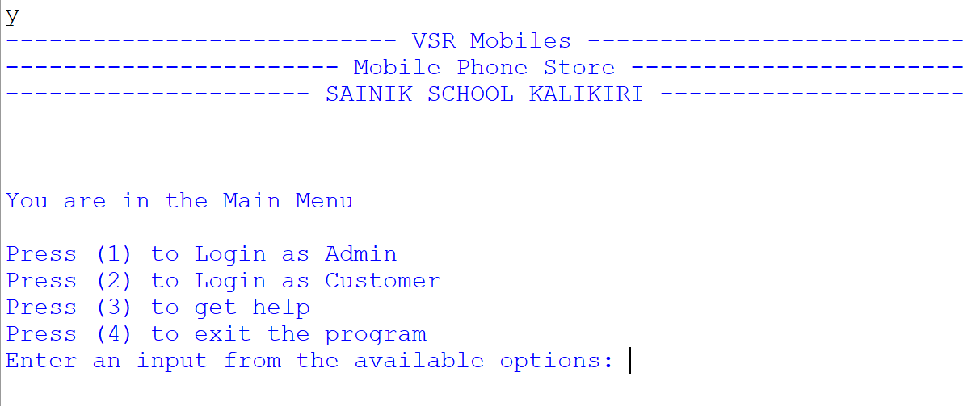
This is the start of the program, we are more conserned about the valid data of our customer so we ask you to login and be safe throughout the process.

Slide 8
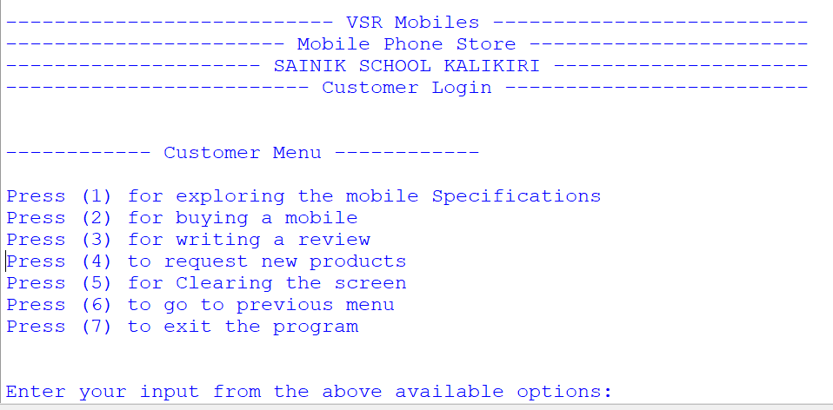
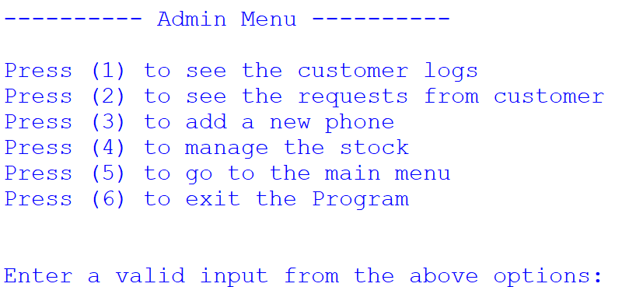
The menu:
We maintain different menus for user and admin so there is no inconvenience throughout the journey of our program.

Slide 9
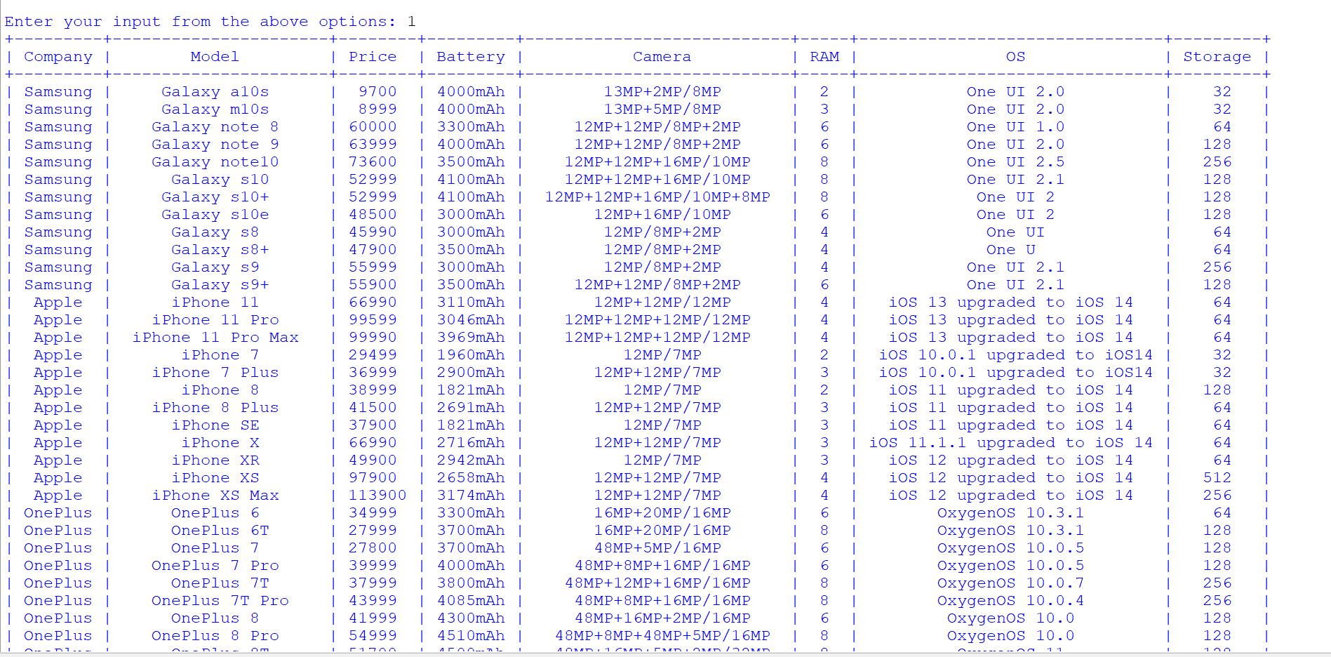
We maintain the data of the user in table format through mysql which makes maintenance of the data easy.

Slide 10
Available Options for Admin:
To see the customer logs.
To see the requests from customer.
To add a new phone.
To manage the stock.
To go to the main menu.
To exit the Program.

Slide 11
Available Options for User:
For exploring the mobile Specifications.
For buying a mobile.
For writing a review.
To request new products.
For Clearing the screen.
To go to previous menu.
To exit the program.

Slide 12
Code of the project :
The code of the project is in Google drive the viewer of the presentation can view the project through the link given below.
https://drive.google.com/drive/folders/15ezGEysKGfTJumcOlXv-mZvBg25hRR64?usp=sharing

Slide 13


